Slide 1


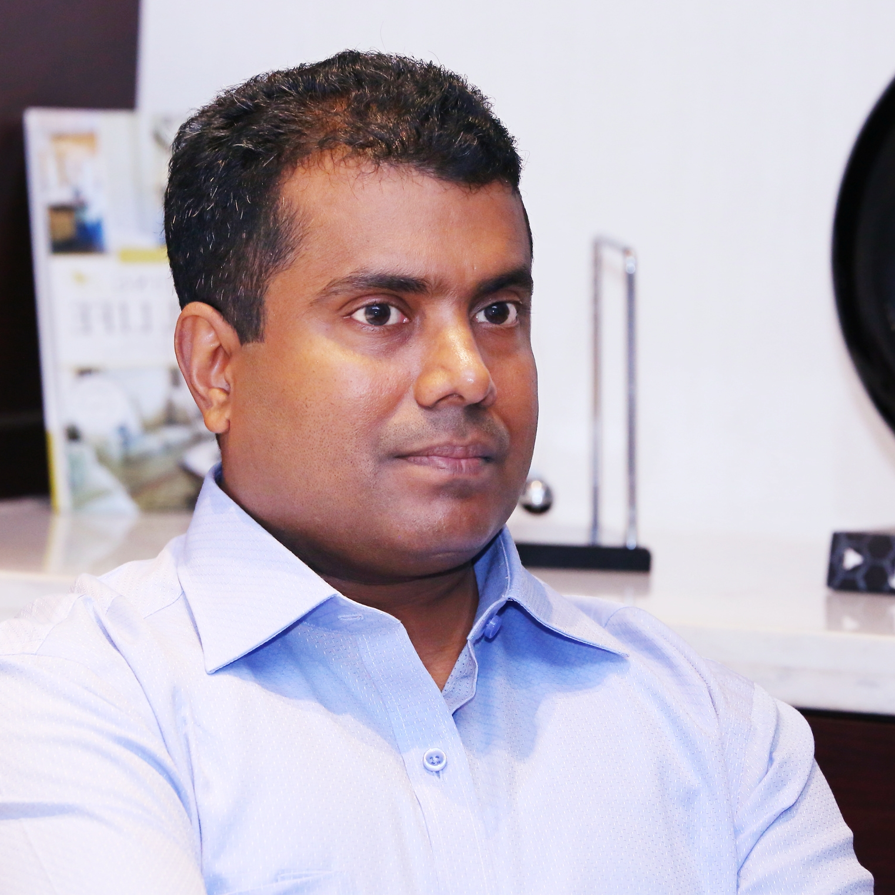
Getting to Know Me
Work
Personal
My role
GM (Cashew)
Significant others / family members / furry friends in my life
Wife Bindu Rajeesh, Son Niranjan and daughter Niharika
Tenure in ofi/Olam
29 Years
How I enjoy spending my free time
Movies, Gardening, Badminton
Previous companies I have worked at
NA
My favorite / comfort food
Fish
Why I joined ofi/Olam and what keeps me here?
Freedom and rights to act keeps me here
My favorite song
Text
Rajeesh Neelanjeri
A few fun facts about me
Text
This is me outside work, doing stuff I enjoy in my life …

